Slide 1
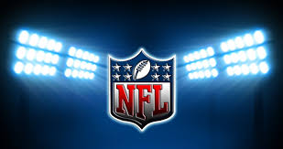
Predicting Offensive Play Calls of the
National Football League
C1C Patrick Mackintosh
C1C Jacob Lindell
Econ 465 Final Project
Insert LOGO

Slide 2
Overview
Motivation
Problem
Goal
Data
Models
Key Findings
Predicting Real Play Calls
Limitations of Analysis
Recommendations
Future Work

Slide 3

Motivation
Sports Analytics
Gary Kubiak
Brian Burke
Notes:
Sports Analytics-
Growing industry.
now there are companies that have sports analytics branches (like Pedurco Group)
Took an entire class about it last year
Gary Kubiak-
He has said that he is trying to get rid of one of the offensive coordinators in his headset in order to put an analyst in there to help with play calling
Brian Burke- Green Bay vs. Seattle Seahawks NFC Championship 2014. (Advanced football analytics)

Slide 4
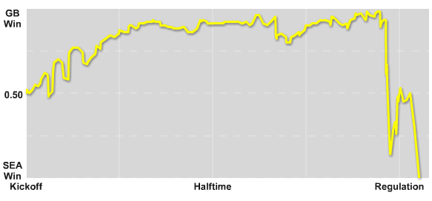
Green Bay vs. Seattle Seahawks NFC Championship 2014
Notes:
As you can see, Brian Burke constantly analyzed the probability of each team winning based on the decisions they made throughout the game. GB had the best chance of winning for 3.5 quarters, but ended up losing in the end.
13-0 GB after 1st qtr
16-0 GB at half
16-7 after 3rd
19-7 GB, GB picks off Seattle with 5 min left

Slide 5
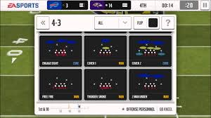
Problem
Play calling is:
Biased
Notes:
Biased- Some defensive coordinators have one mindset, and that can be used against them.
Ex: If a Defensive Coordinator is known for playing man to man coverage, the offensive coordinator can use that and make plays that work well against man to man.
Tried to make our model as unbiased as possible in order to get most accurate results

Slide 6
Goal
Find a model that predicts the next play
Run vs. Pass
Left, Middle, Right
Short, Deep
75% accuracy
Notes:
Our goal was to find a model that could predict the next play an offensive team is going to run with a high degree of accuracy.
After some trial and error, we realized it would be extremely hard to do play type and play location in same model.
NC State student that made a model than can predict with 75% accuracy, but that is looking at specific quarters and teams.

Slide 7
Data
Pro-Football-Reference
Cross-sectional
Complete
Creation of New Variables
Notes:
Bryan Povlinski collected play by play data from every NFL game in 2013 and 2014.
Had 58 variables for every play, but we narrowed it down to the variables shown
Cross-sectional
Although there is a time variable, we did not believe it was necessary to see how the variables changed over time.
We look at many individual plays, so time-series and panel data are not applicable.
Complete
Over 2 million data points, and we were only missing less than 1% of the data points
The missing data is not absent, it is just values that if they do not happen are left intentionally blank (ex. Fumble)
New Variables:
Lagged interception, fumble, sack
Given in an Excel spreadsheet, so it is easily imported into Stata and R.
Notes on data:
Only run/pass plays, no kneels, punts

Slide 8
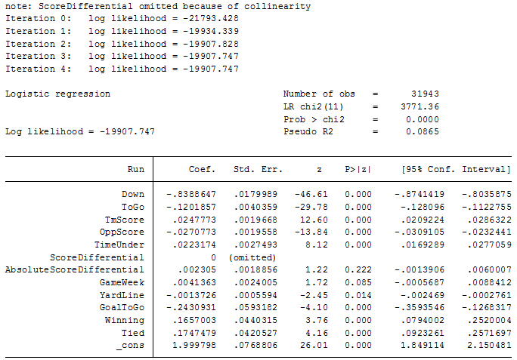
Logit Model
Binary Outcome
Non-linear
2 iterations
Notes:
Binary outcome
Non-linear
Ie yardline
Does well with dichotomous nd vars
Dummy variables for team

Slide 9
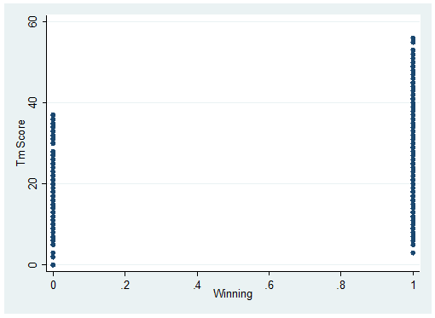
Problems with Logit
Assumptions
Error independence
Multicollinearity
Notes:
Inflated standard errors
Biased coefficients

Slide 10
RandomForest
Extremely accurate classifier
Few assumptions
“BlackBox”
Stable

Slide 11
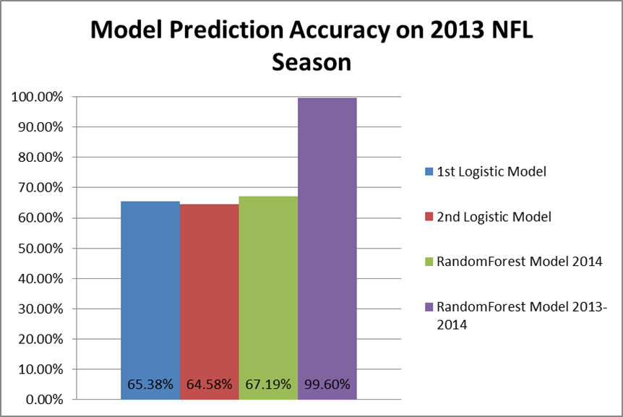
Key Findings

Slide 12
Predictive Power
Run versus Pass: 70% accurate
Play Location: 45% accurate

Slide 13
Predicting Real Play Calls
Model in practice
Denver Broncos vs. Seattle Seahawks (week 3, 2014)
OT; 20-20
Seattle has ball on 6 yard line
1st and goal

Slide 14
Limitations of Analysis
“BlackBox” analytics
Hard to predict new seasons
Multicollinearity

Slide 15
Recommendations
Conditional models
Train off current data

Slide 16
Future Work
Would Do with more time-
Split up data by quarter, leading/losing, etc.
Split up by team
Falcon Football

Slide 17
Questions?

